Slide 1


ECEN 403 Final Presentation Team 16, FET Control Box Jacky, Luke, Max, and Sydney Dr. Robert S. Balog

Slide 2
Project Description
Problem Summary: The FET box, designed in 2003 for power electronics education (e.g., ECEN 438) and research, is still in use but cannot be repaired due to the unavailability of replacement parts.
Solution Summary: Modernize the previous design to enhance robustness and usability while adding new features and improving existing ones.

Slide 3
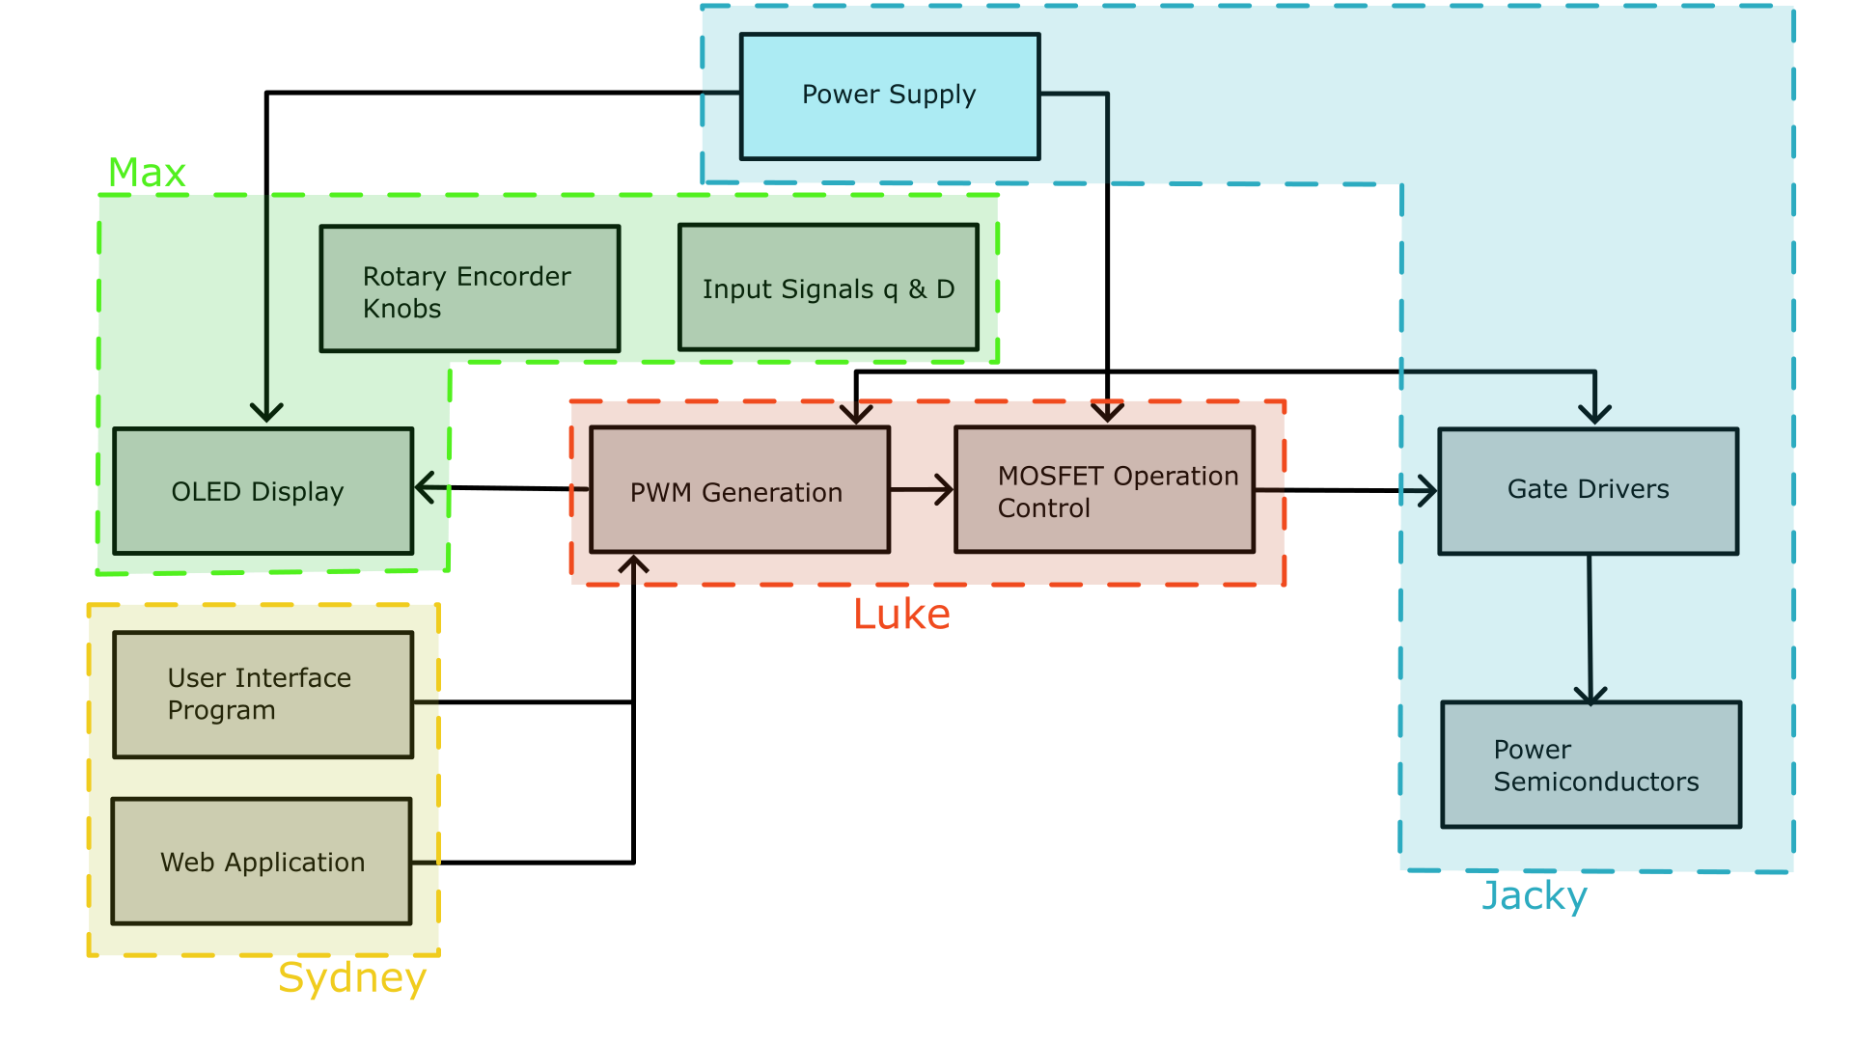
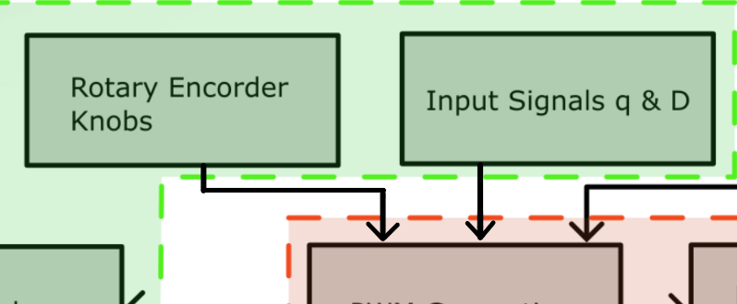
Diagram of Subsystems

Slide 4
Engineering Design Accomplishments
Microcontroller Subsystem
Luke Bethancourt
Developed PIC32 firmware that generates 2 PWM signals for three operating modes, and firmware that allows communication of commands between a pc and the PIC. Co-designed PCB schematic and layout.

Slide 5
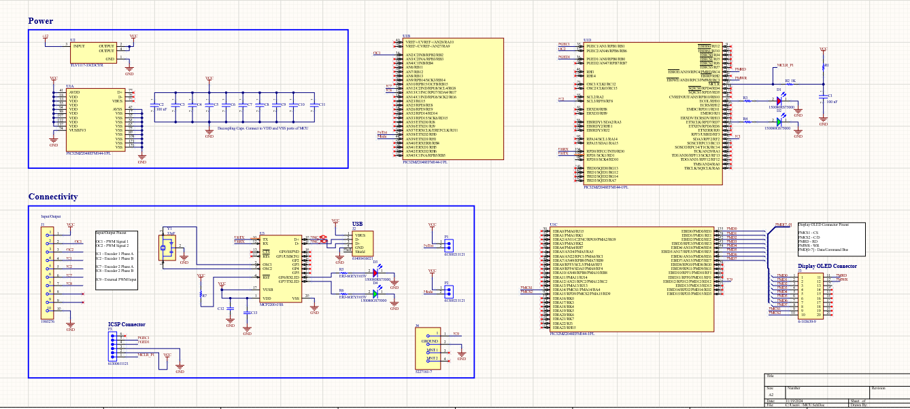
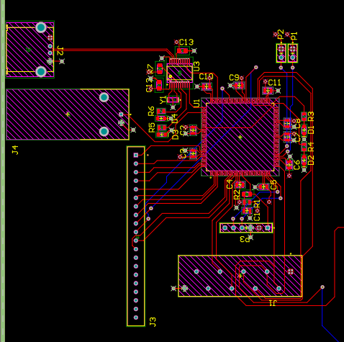
ad
Microcontroller Subsystem
Luke Bethancourt
s

Slide 6
Remaining Tasks
Microcontroller Subsystem
Luke Bethancourt
Before Demo:
Assembly of the PCB must be finished, validation of the PWM signals and operation modes must be tested after the completion of the PCB.
A few tweaks to my code to get it ready for demo.
Integrating Max's code with mine to prepare it for flashing onto the PIC
Next Semester:
Add non-essential commands to be implemented for expanded user control.
Possible change of the USB connection to USB-A to USB-C or USB-A to USB-B.

Slide 7
Engineering Design Accomplishments
-UI & Application Subsystem-
Sydney Naddy
Developed a user interface and application that allows students to control the FET box directly from their computers. The application replicates the functionality and interface of the physical box while offering the added benefit of enhanced ease of use.

Slide 8
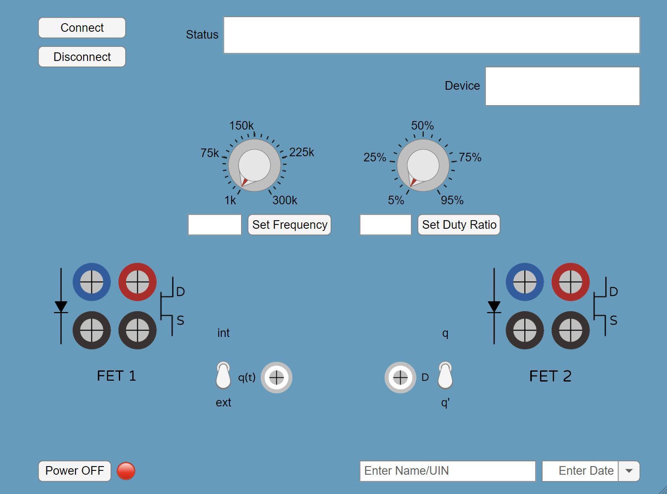
-UI & Application Subsystem-
Sydney Naddy
Ongoing Status Bar
Connect to Device
Device Information
Sends Frequency and Duty Ratio Value to Device
Student Information
Sends Mode Selection to Device

Slide 9
Remaining Tasks
-UI & Application Subsystem-
Sydney Naddy
Before the demo:
- Replace some of the standard SCPI commands with custom commands tailored for the microcontroller
- Validate communication between the device and computer
Next semester:
- Validate the UI communication with the FET Box
- Expand capability to possibly support multiple FET boxes
- Work with Max to implement a verification to the student that the value was changed in the FET Box such as LEDs or on the display
- Work with Luke if type of USB is altered
- Package the MATLAB app so it can be shared and used by others either by .mlappinstall file for MATLAB users or compiling the app into a standalone executable for those without MATLAB

Slide 10
Engineering Design Accomplishments
-Power Supply Subsystem-
Jacky Chen
Designed a power supply that takes the AC voltage from the wall; 85V-240V AC range
Converts to 12VDC 1A for powering components: MCU, optocouplers, voltage regulators.
2 isolated outputs that powers the MOSFETs.
Designed a custom transformer that has 2 primaries and 3 secondaries
Primaries from the power supply
One secondary as 12VDC, 1A
Two secondaries that power the MOSFETS.
The identical outputs to the MOSFETs do not have a ground and the components are rated to be 200V 10A as its maximum load that it can run normally.
Components are selected to as 400V and 15A so that nothing fries.
The PCB trace widths are widened accordingly to the high current that will run between components.

Slide 11
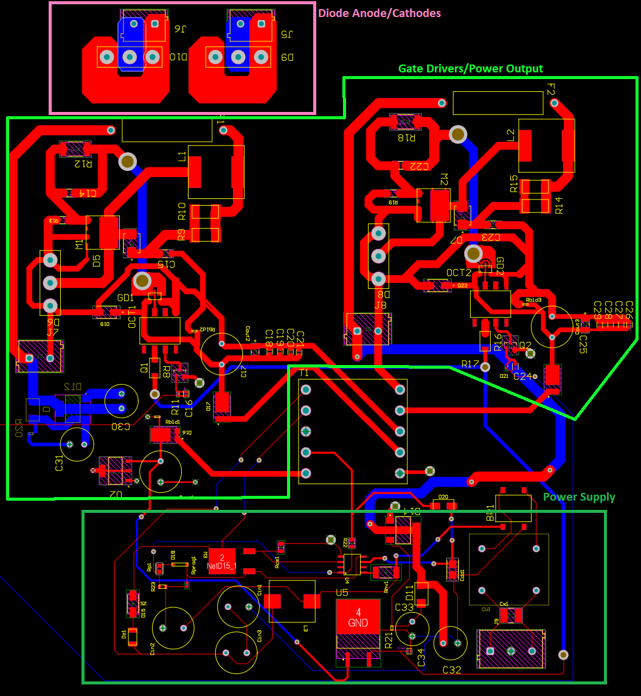
PCB design of the subsystems:
Power circuits for the FETs.
Diode anode/cathode part for convenience.
Power supply for both the MCU and power circuit subsystems.

Slide 12
Remaining Tasks
-I/O Subsystem-
Jacky Chen
Before demo:
Assembly of all the components onto the PCB.
Verify that the power supply section outputs the intended voltage and current.
Test the FET circuits using buck or buck boost with an external circuit.
Next semester:
Optimize the PCB design
Ensure that the power supply can handle supplying power into other subsystems.
Integrate the PCB board and its ports into an enclosure.
Add a heatsink for the PCB components.

Slide 13
Engineering Design Accomplishments
-I/O Subsystem-
Max Garza
Programmed an OLED display to show current device operation status.
Interfaced encoders to adjust frequency and duty ratio with “coarse” and “fine” mode.
Programmed microcontroller to emulate external PWM signal in real time.
Co-designed microcontroller schematic and PCB.

Slide 14
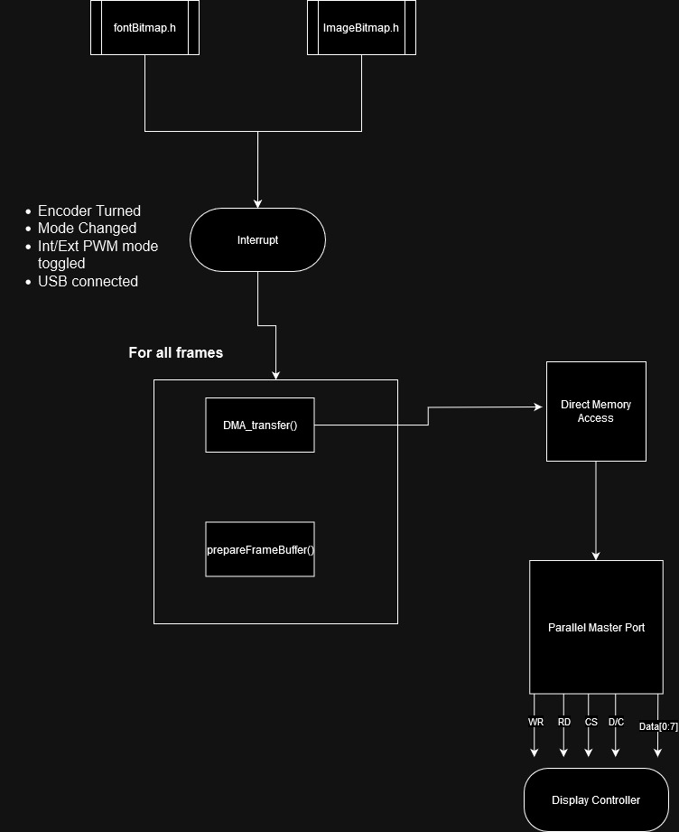
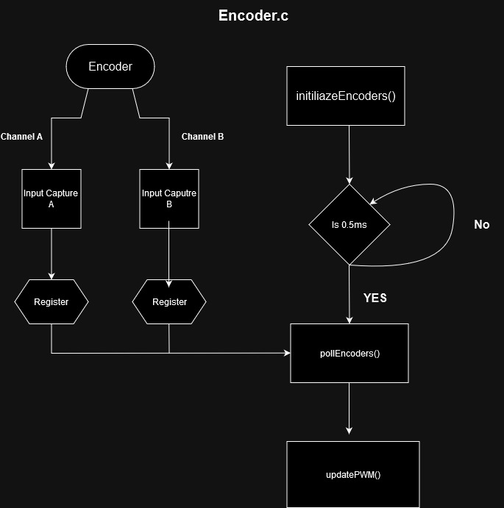
-I/O Subsystem-
Max Garza

Slide 15
Remaining Tasks
-I/O Subsystem-
Max Garza
Before Demo:
Encoders:
Input Capture Interrupt
External PWM:
Input Capture Interrupt
Display:
Verify that data & commands get received by display
PCB:
Finish Soldering PCB
Next Semester:
Revise FUSION 360 model to comply with dimensions in ICD
Construct enclosure

Slide 16
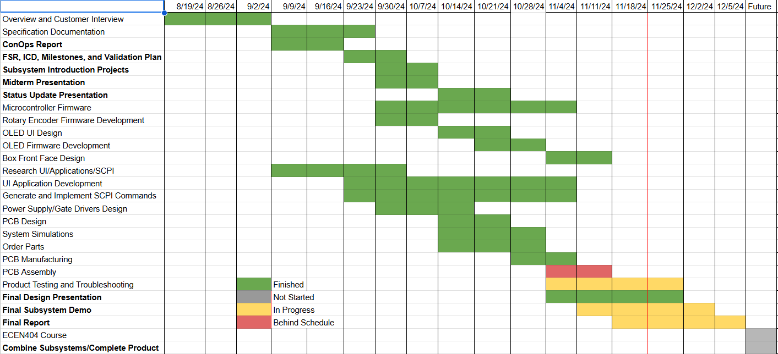
Execution Plan

Slide 17
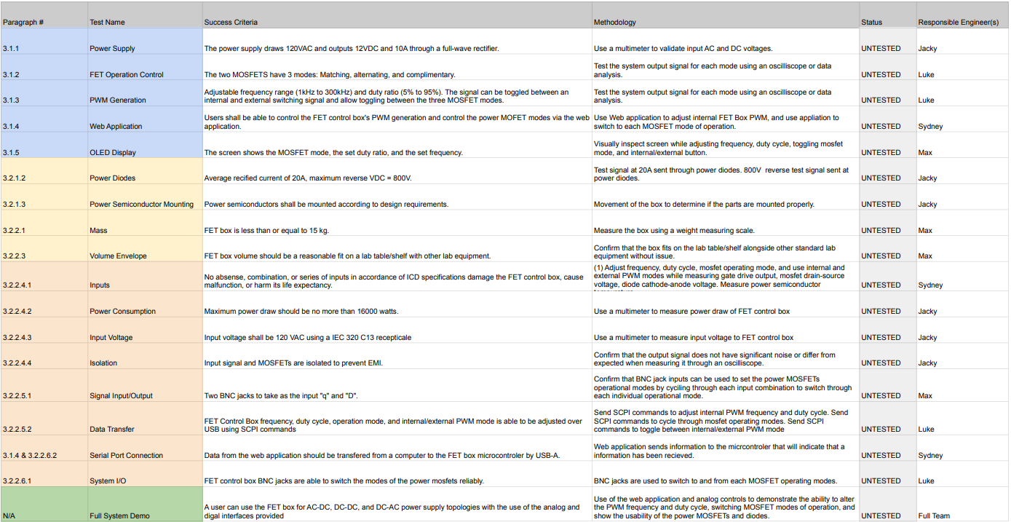
Validation plan

